Slide 1



Sentiment Analysis
View in Power BI
Last data refresh:
8/28/2019 2:38:12 PM India Standard Time
Downloaded at:
10/23/2020 6:14:20 PM India Standard Time

Slide 2
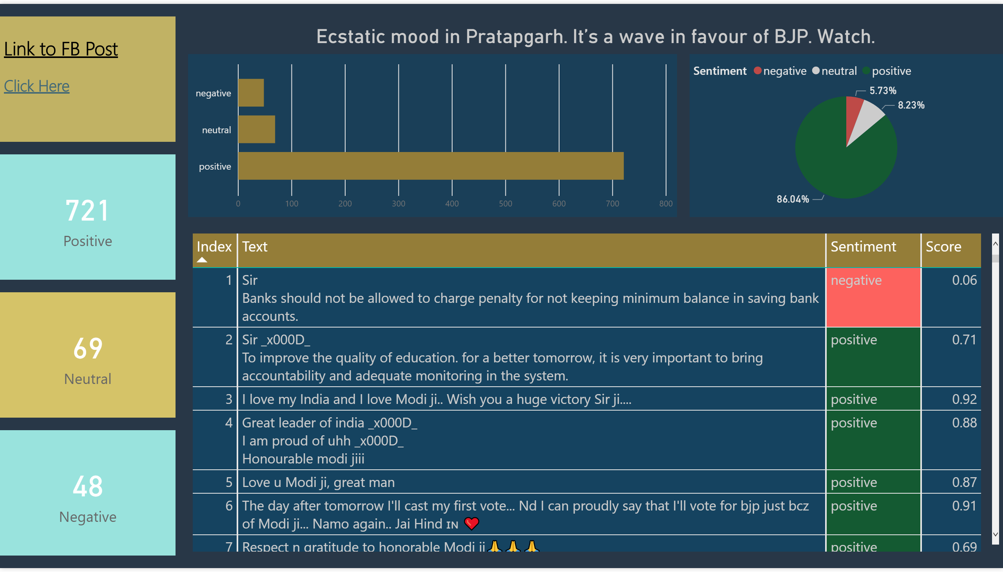

Slide 3
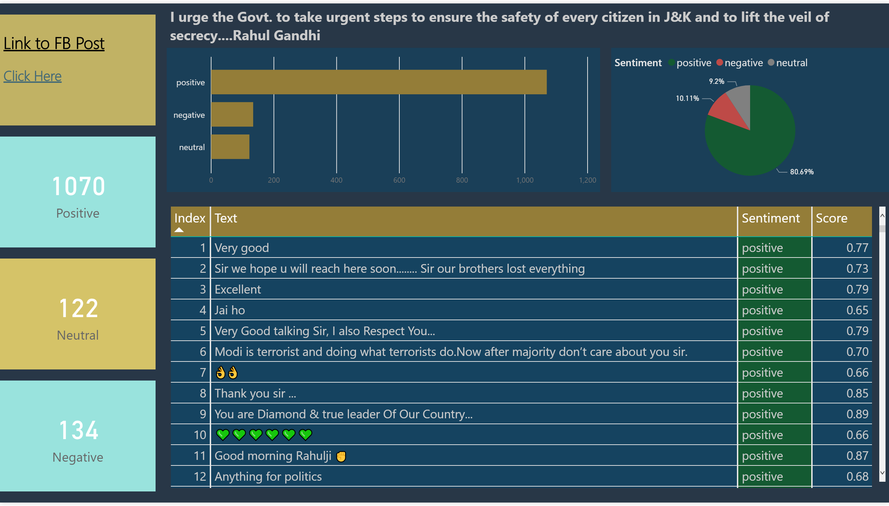

Slide 4
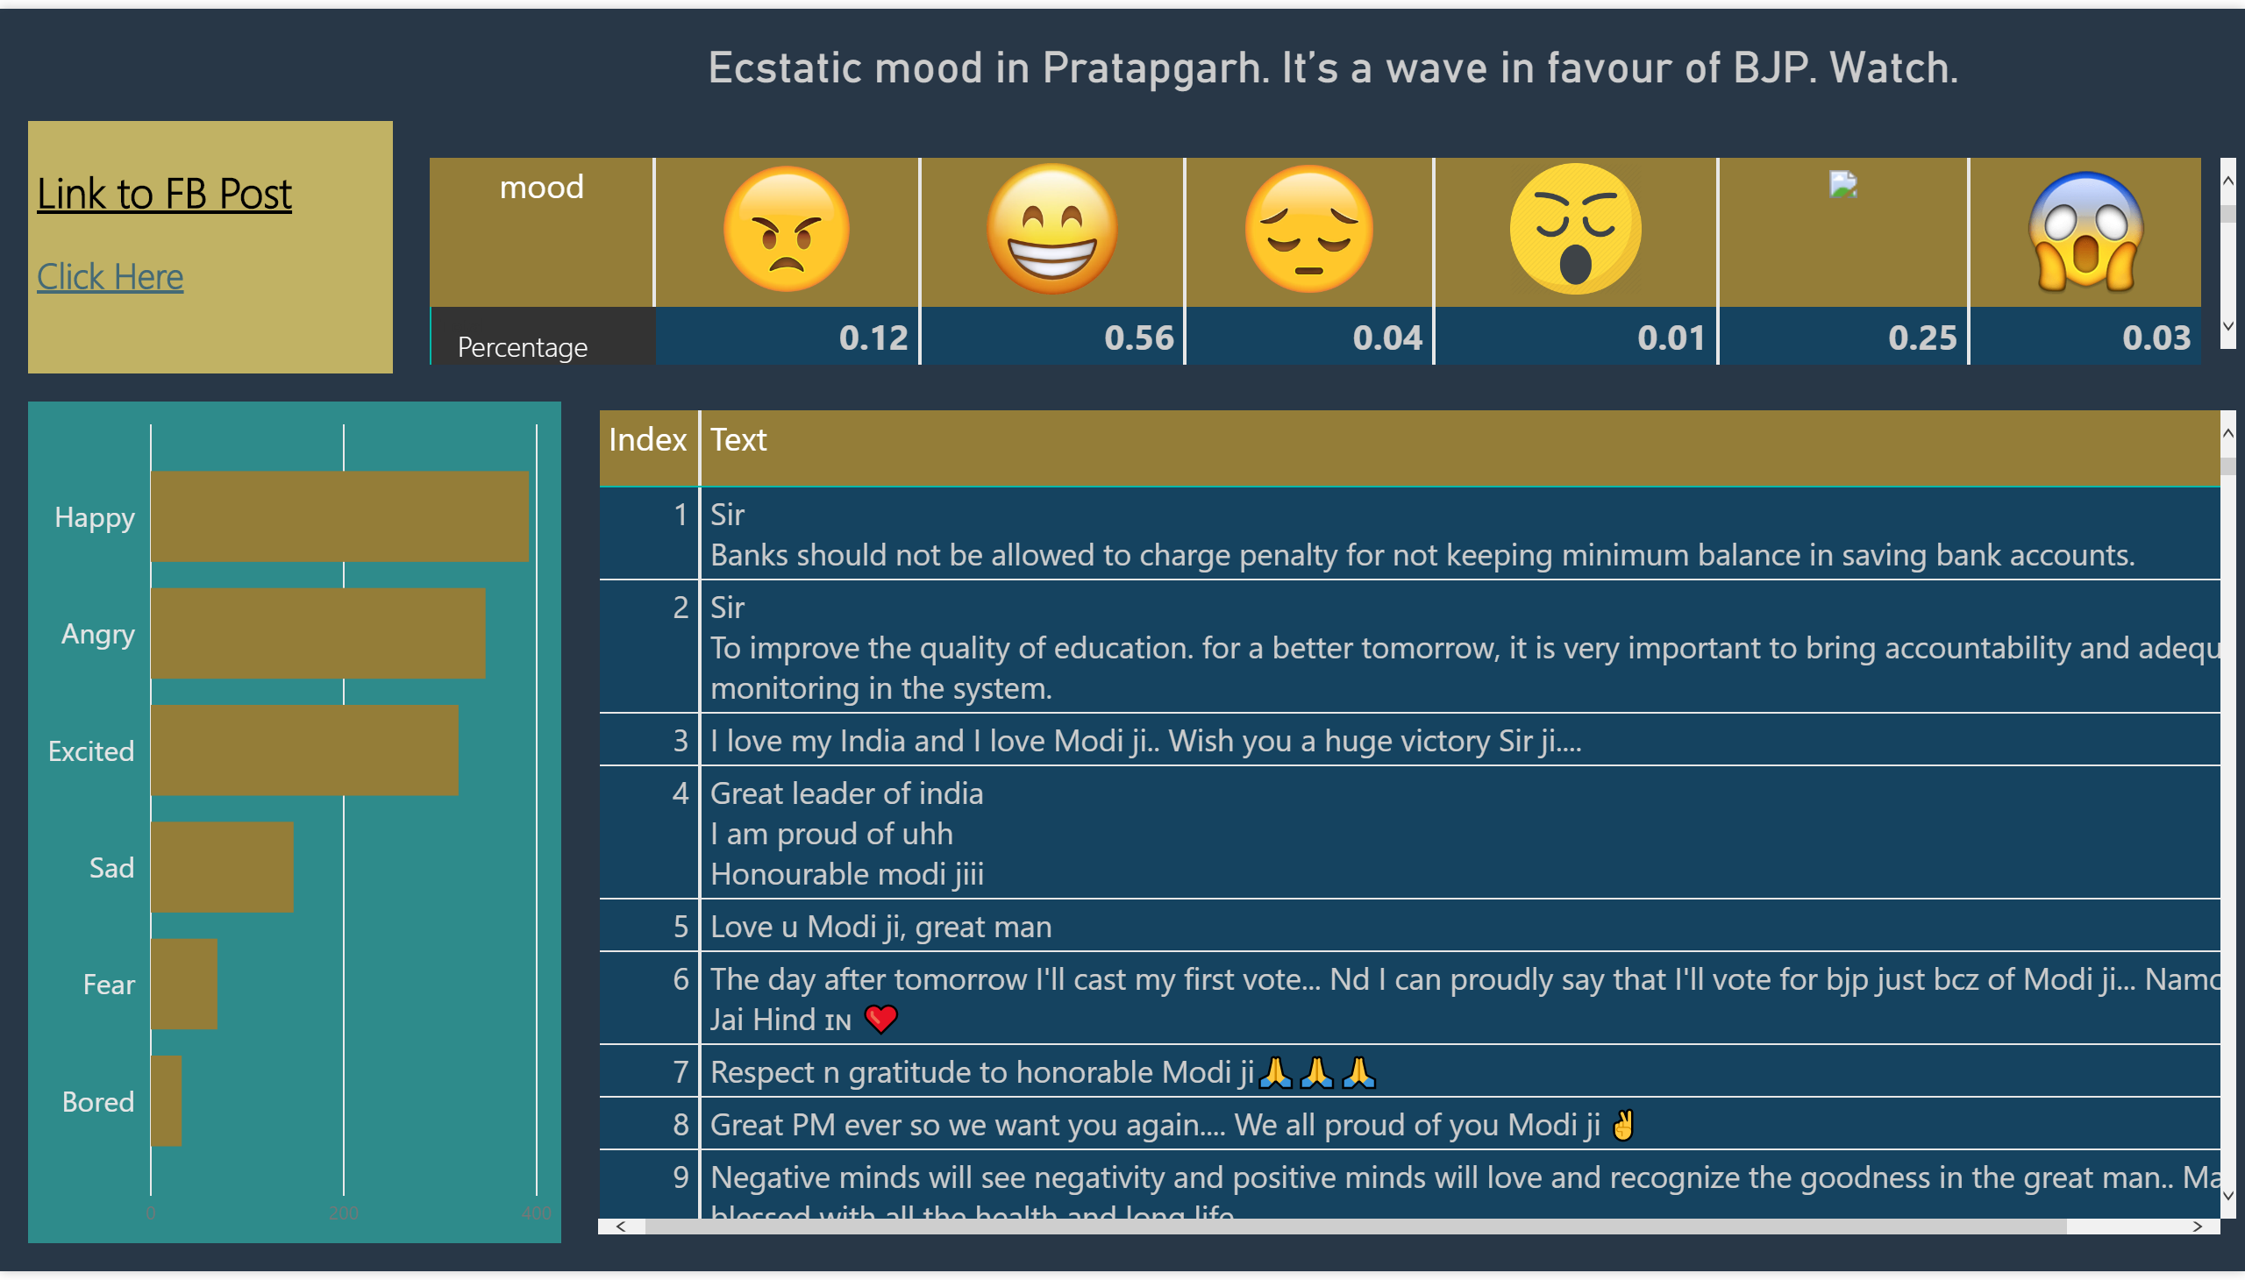

Slide 5
